Slide 1
Finite Wordlength Effects
Ajit S. Bopardikar
Conexant Systems Inc.
Hyderabad

Slide 2
Scope
Study the effects of finite wordlength representation of filter coefficients on the output

Slide 3




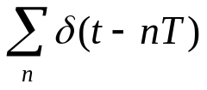


Example of an Ideal System…
D/C

Slide 4





…with Introduction of Nonlinearities…
D/C
System response will change because of the quantization of

Slide 5



…Modeling Nonlinearities
D/C

Slide 6
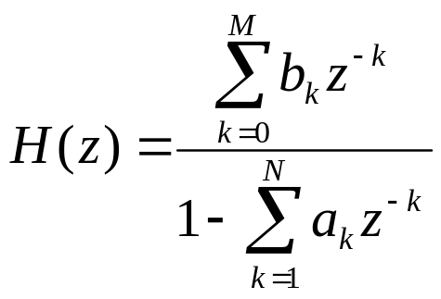
Effect of Coefficient Quantization
Implementation can be based on minimizing hardware or software complexity
Implementing structure determines the quantization noise generated by the system
Some structures are more sensitive than others to perturbations of coefficients

Slide 7
Effect of Coefficient Quantization
Quantizing coefficients of a difference equations results in movement of poles and zeros to new positions in the z-plane
Frequency response perturbed from the intended frequency response
System implementation needs to be robust so that changes in the coefficients do not cause huge perturbations in frequency response

Slide 8
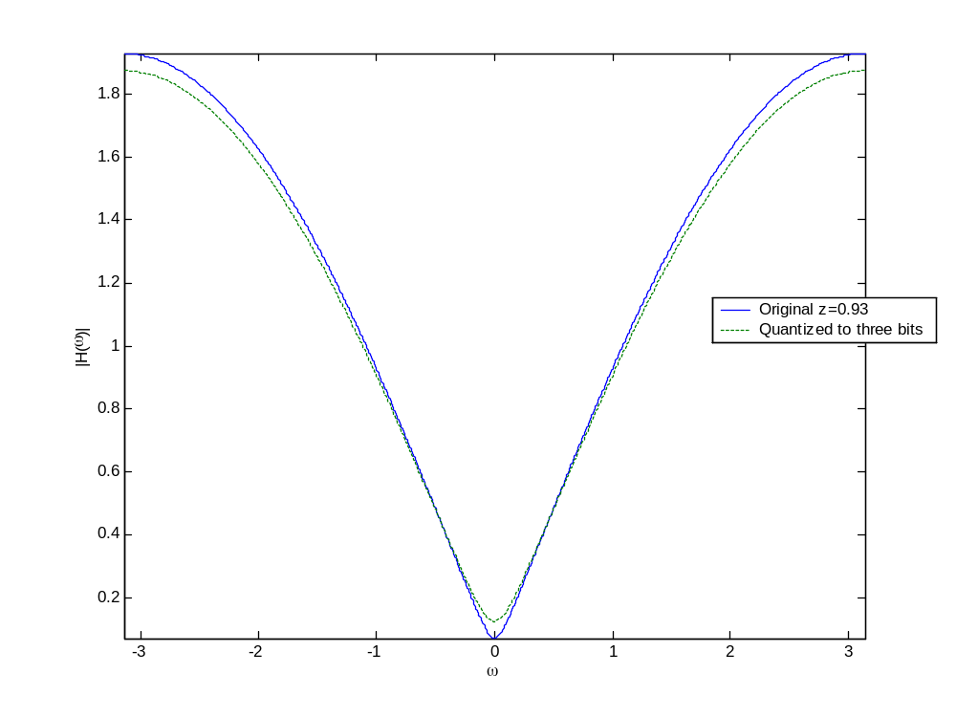
Effect of Coefficient Quantization: Example-single zero: Magnitude

Slide 9
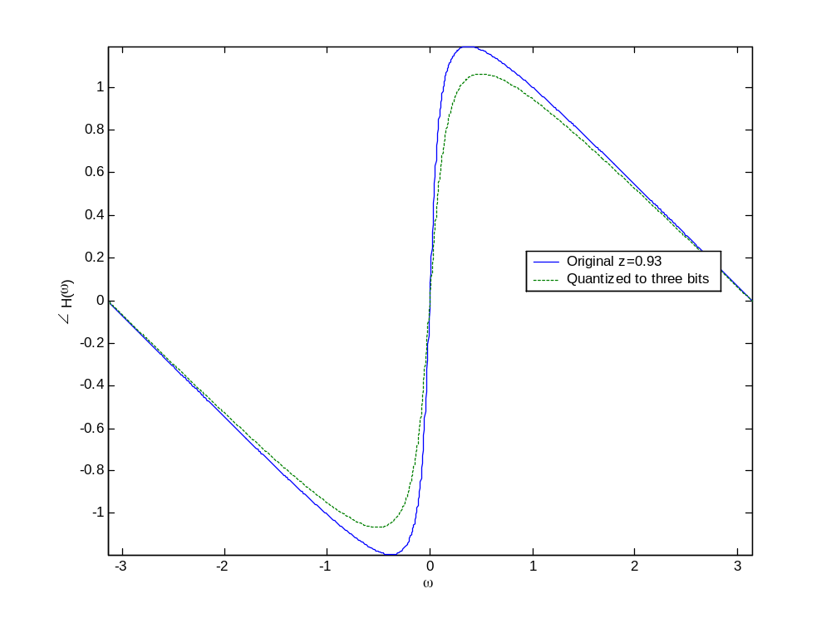
Effect of Coefficient Quantization: Example-single zero: Phase

Slide 10
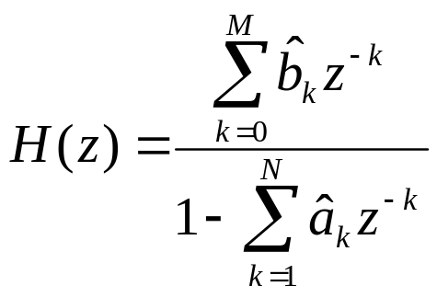
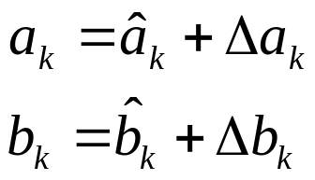
Direct Form Coefficient Quantization: Sensitivity Analysis

Slide 11
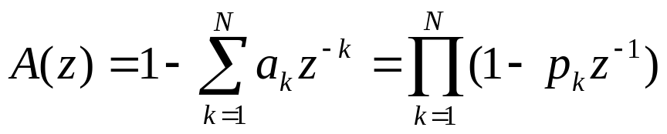
Analysis: Direct Form Coefficient Quantization
Quantizing the coefficients affects all the poles and zeros and hence the overall frequency characteristics
Consider

Slide 12
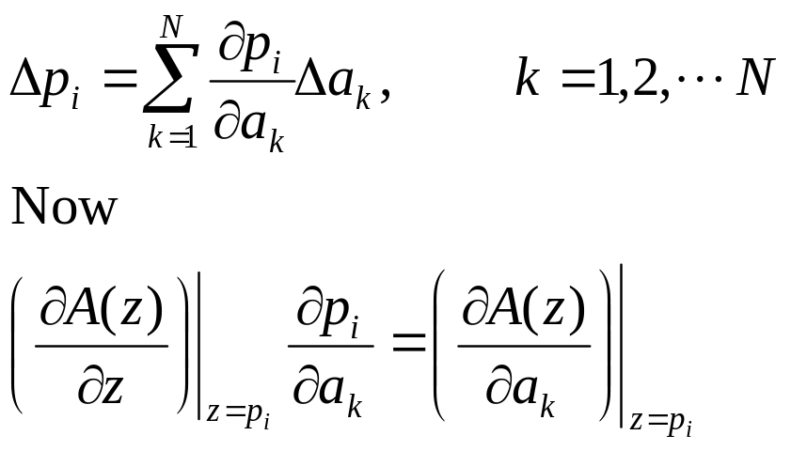
Analysis: Direct Form Coefficient Quantization
We can represent the errors in pole positions in terms of the errors in representing coefficients as

Slide 13
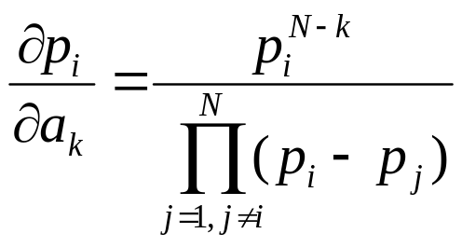
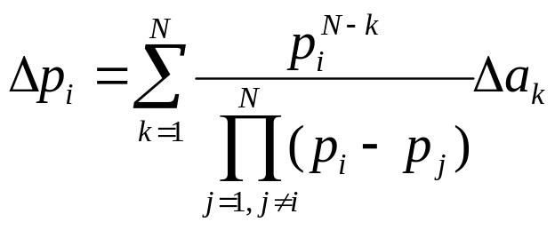
Analysis: Direct Form Coefficient Quantization
Similar result can be obtained for the zeros (numerator
of a system transfer function)‏

Slide 14
Interpretation: Direct Form Coefficient Quantization
This is a measure of sensitivity of how changes in denominator coefficients result in changes in the pole positions
If the poles are tightly clustered as in a narrow band filter, small changes in the denominator will result in large changes in pole value.
Especially true in direct form structures

Slide 15
Interpretation: Direct Form Coefficient Quantization
Larger the number of clustered poles and zeros, greater the sensitivity
Error can be minimized by maximizing the distance between poles

Slide 16
Cascade Structures
Most singularities (poles and zeros) are complex conjugates
Error in each pole/zero pair independent of other poles/zeros
Therefore generally far less sensitive to coefficient quantization than the corresponding direct form

Slide 17
Parallel Form
Zeros in parallel form often realized implicitly
Use partial fractions to compute zeros: dependent on all other singularities
In general second order systems are not very sensitive to quantization
Parallel forms are much less sensitive to coefficient quantization as compared to direct forms
Cascade forms are superior to parallel form implementations in preserving zero positions and hence stopband behavior

Slide 18
Summary
Systems that are theoretically equivalent sometimes have vastly different performances when finite precision arithmetic is used to implement them

Slide 19
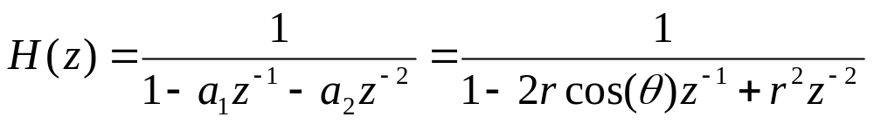
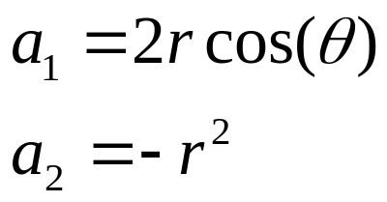
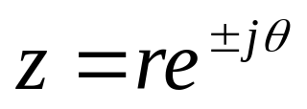
Two-Pole Filter Section
General Representation
These are quantized
Poles

Slide 20
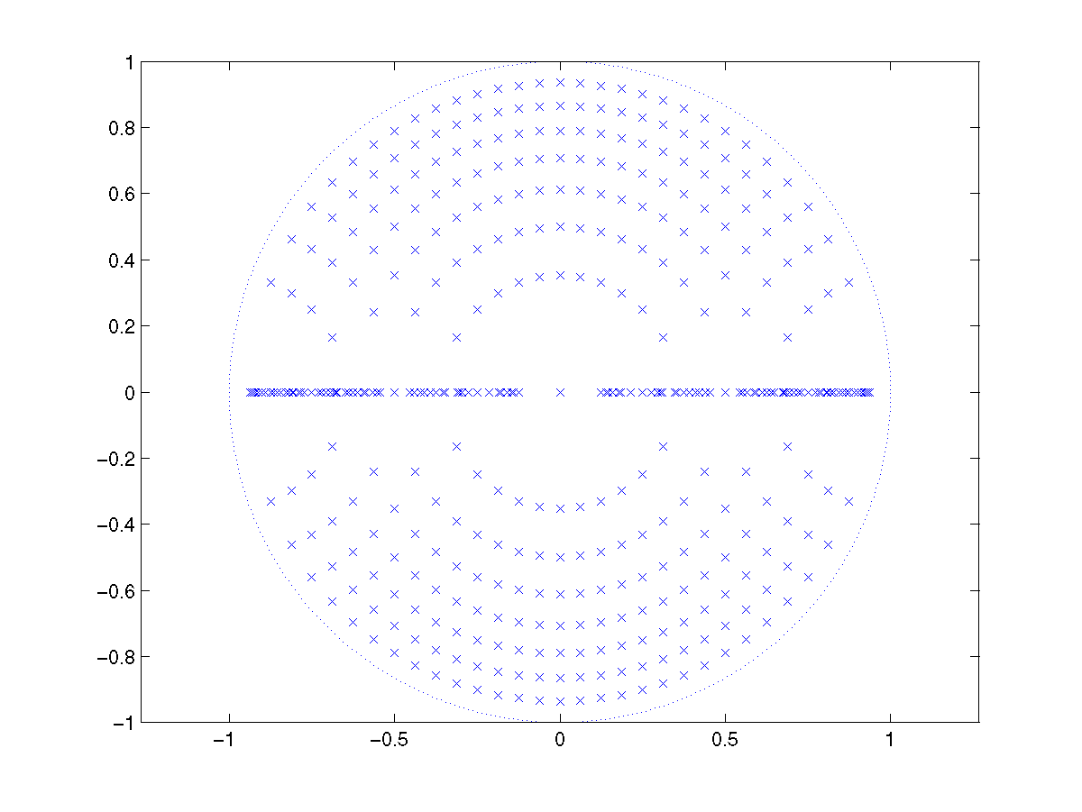
Quantized Pole Locations
4-bit 2’s compliment quantization
Source: http://cnx.org/content/m11926/latest/

Slide 21
Quantized Pole Locations
Grid sparse around the real axis
Poles originally around the real axis will shift a lot more than poles located elsewhere
Quantization will degrade system performance

Slide 22
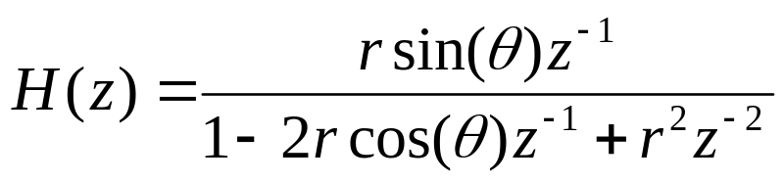



Coupled Form Implementation of Complex Conjugate Pole Pair

Slide 23
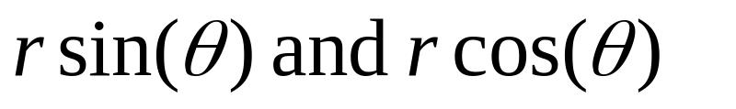
Coupled Form Implementation
Same poles as the two-pole filter section
For implementation
need to be quantized
Poles lie on a rectangular grid
Higher number of computations

Slide 24
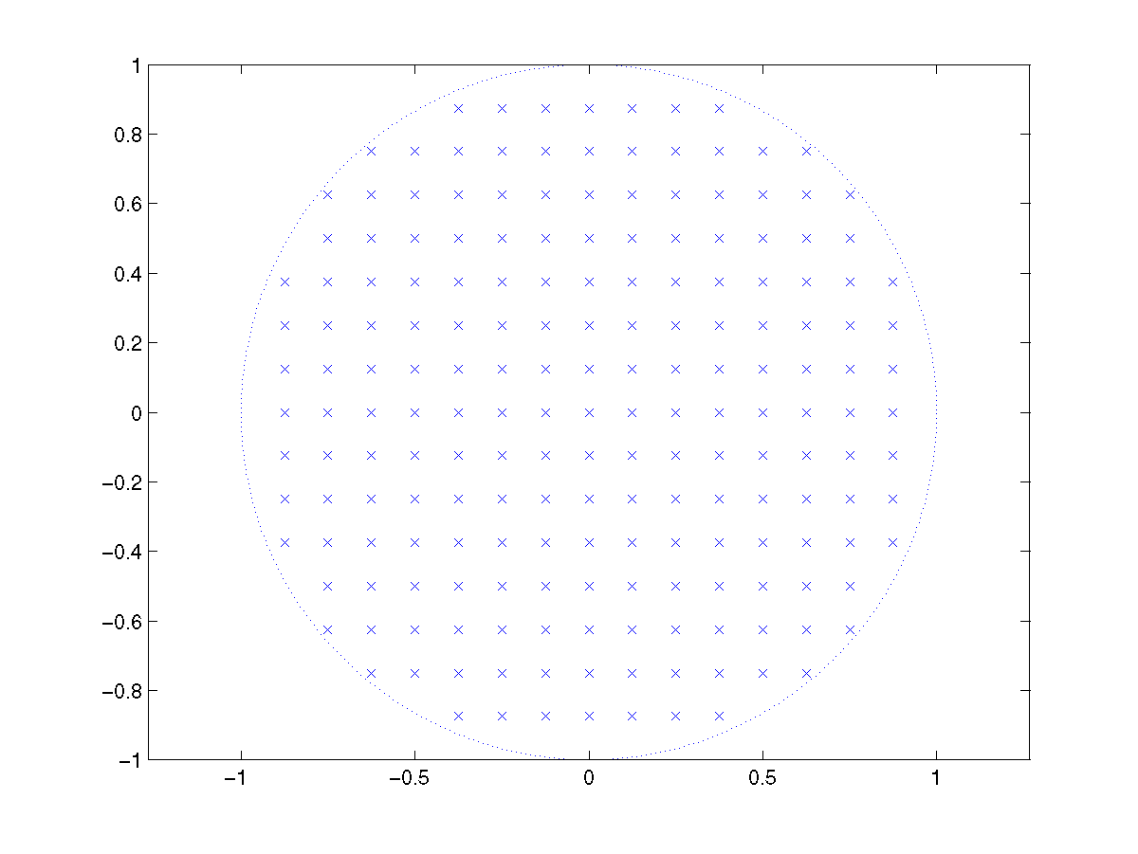
Coupled Form Implementation
Source: http://cnx.org/content/m11926/latest/

Slide 25
Quantization of Coefficients in FIR Filters
For reduced sensitivity to coefficient quantization, FIR filters with a large number of zeros can be implemented using a cascade of second and first ordered filter sections

Slide 26
Linear Phase FIR Filters
Quantization preserves linear phase
Coefficient quantization affects the magnitude response only
At least 10 bits should be used to represent filter coefficients
As filter length increases, coefficients will need to be represented using more bits to maintain error at the same level

Slide 27
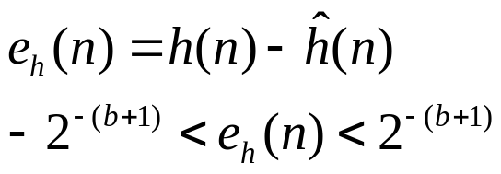
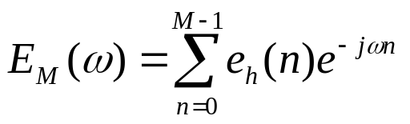
Error Analysis
M length filter
All coefficients less than 1
Scaled with binary point between the sign bit and msfb
b+1 bit rounding of each coefficient

Slide 28
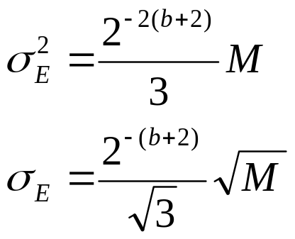
Error Analysis
Variance is sum of variance of M random variables
For every increase in M by a factor of 2, precision must be increased by two bits to maintain the standard deviation

Slide 29

Cascade Structures for FIR Filters
For very long filters and for limited wordlength requirements, cascade form can be employed for reduced sensitivity to quantization
Cascade filters will preserve zeros on the unit circle
Real zeros will continue to be real
Zeros at can also be preserved

Slide 30
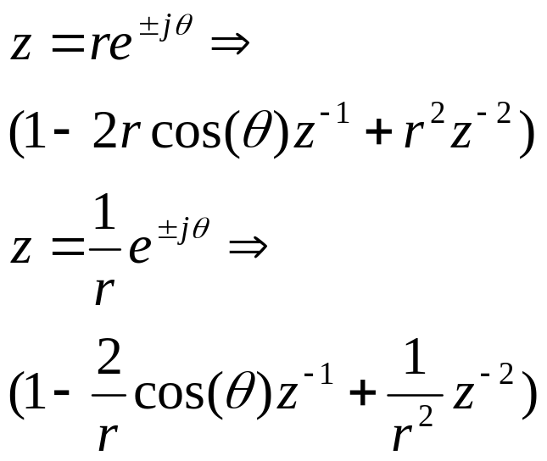
Cascade Structures for FIR Filters
Mirror image zeros may not be reproduced and this could compromise linear phase

Slide 31
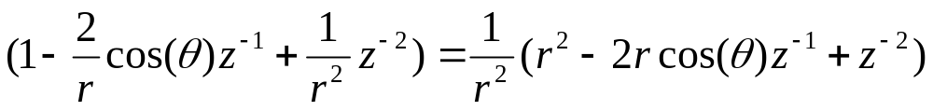
Cascade Structures for FIR Filters
r and its reciprocal will be quantized differently.
Mirror image symmetry of zeros will be lost as will linear phase property
Solution
Absorbed in the gain

Slide 32
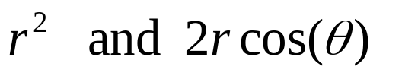
Cascade Structures for FIR Filters
Only the factors
need be quantized
Zeros now occur as mirror image pairs and symmetry is preserved even when coefficients are quantized

Slide 33
Reading List
Oppenheim, A. V., Schafer, R. W., “Discrete-time Signal Processing,” Prentice-Hall, India, 1989.

